Slide 1

Soccer Card Clash
Artur Chonov, SE

Slide 2


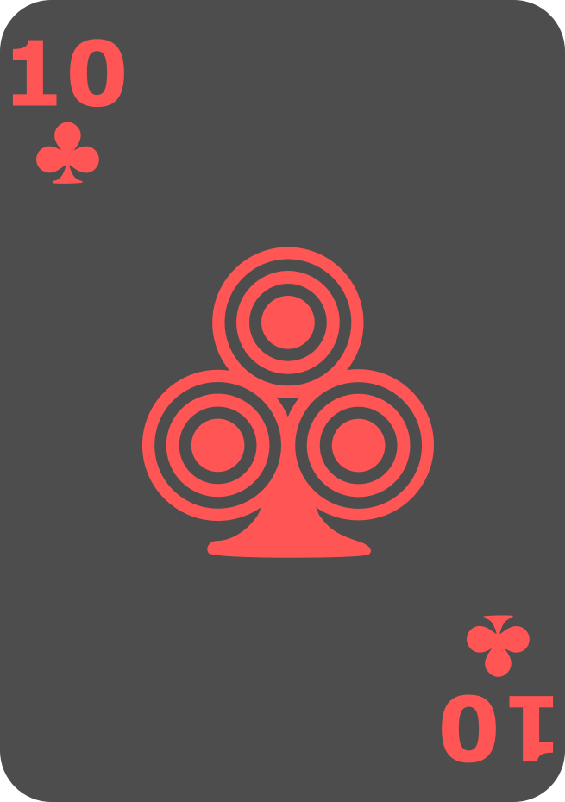
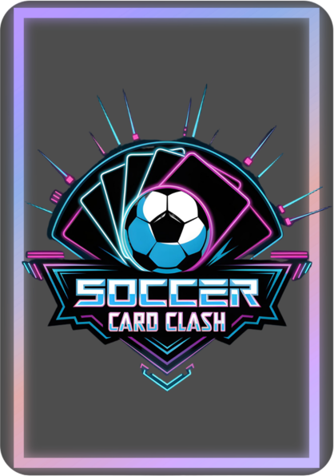
Soccer Card Clash
Attacker
Defender
Card
Flipped
🔄
Players take turns as Attacker and Defender.
Standard 52-card deck
Cards represent power values
Ace is strongest (normally)
Special Rule: 2 can beat Ace — for fairness

Slide 3
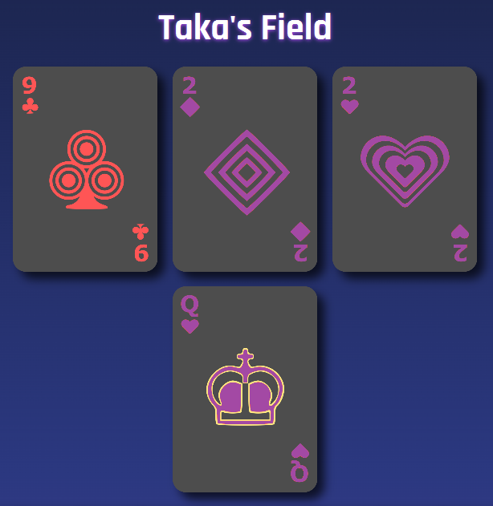
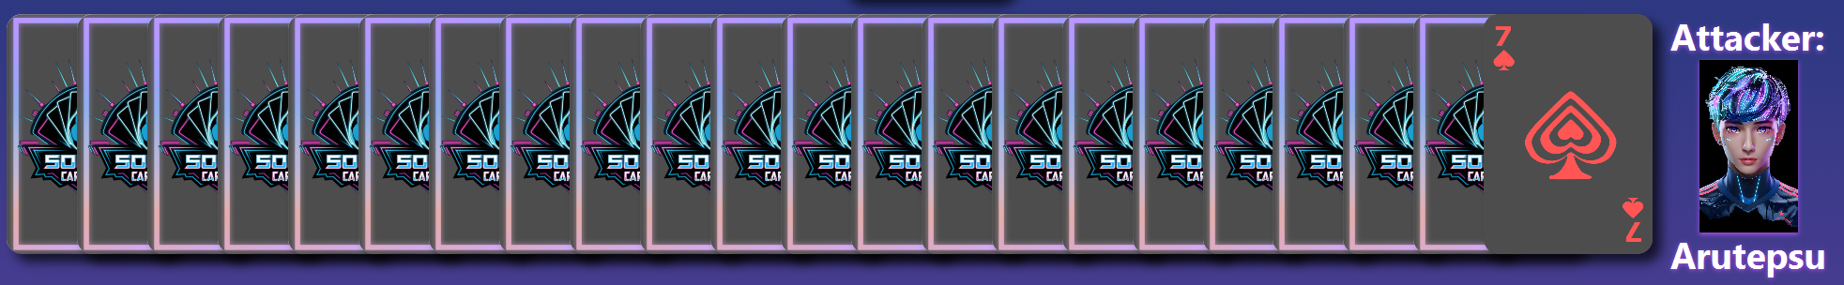
Soccer Card Clash
Defender Cards - List
The defending player sets up 3 defenders and 1 goalkeeper
Cards are sorted automatically when roles switch
The goalkeeper is always the strongest available card
Attacker must defeat all 3 defenders first
Goalkeeper is protected until defenders are beaten
Only then can the attacker try to score a goal
Attacker Cards - Queue
Attacker always attack using the last card(s) in your hand.
Single Attack uses 1 card, a Double Attack uses 2.

Slide 4
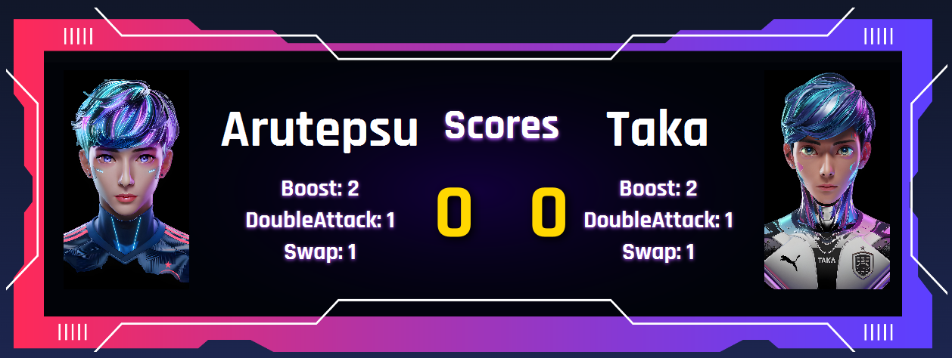
Soccer Card Clash
Attack Outcomes
Action System
Success
Beaten defenders added to the attacker’s queue hand;
Attack continues
Failure
Roles switch
Tie
Compare next-to-last cards; stronger pair wins
Each turn has a limited number of actions
Once used up, no more actions can be performed until the next turn

Slide 5
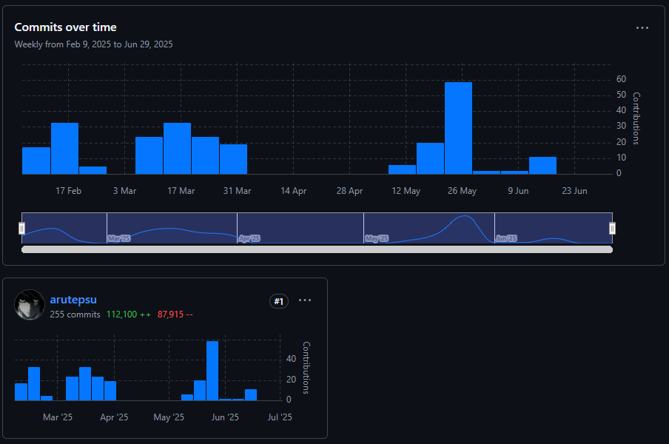
2. Github
Version control allows us to track, manage, and restore changes in the codebase.

Slide 6
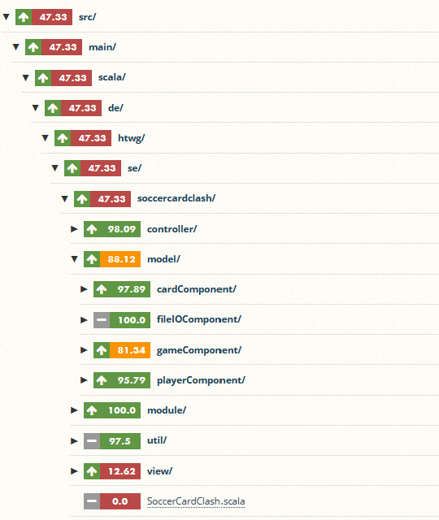
3. Tests and Test Coverage
Why Tests Matter
Automated tests ensure that features work and that future changes don’t break the app.
Code Coverage (Coveralls)
Code coverage tools like Coveralls show which parts of the code are tested.
High coverage = higher confidence and stability.

Slide 7
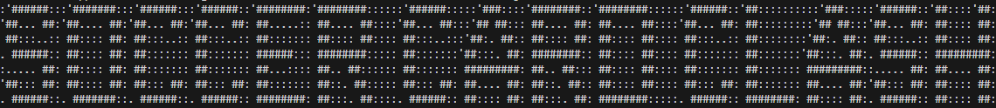
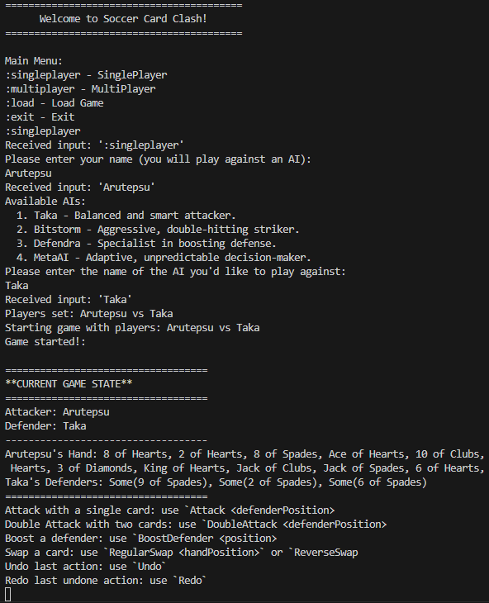
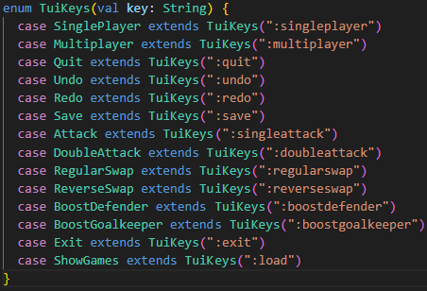
4. TUI
The Text User Interface allows users to interact with the game directly in the terminal using typed commands.
Input based on Tuikeys

Slide 8
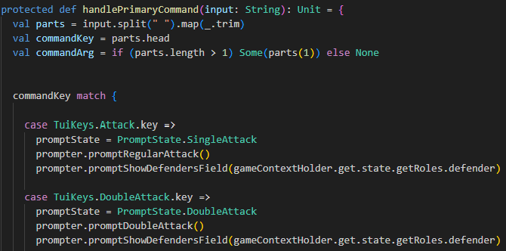
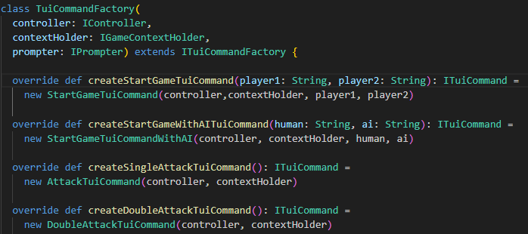
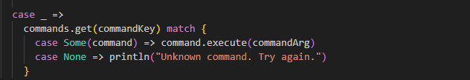
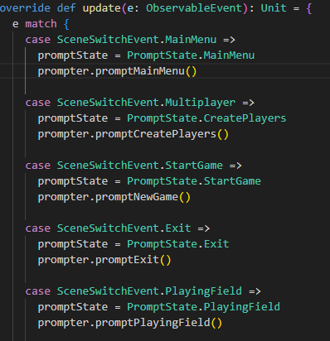
4. TUI
Each action is handled by a TuiCommand
Commands use the controller to update the game state
The TUI is an observer: it reacts to game events and updates the display accordingly

Slide 9
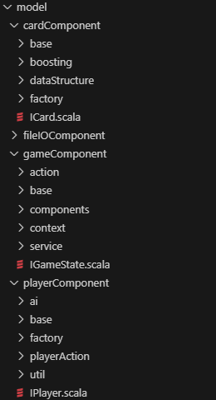
5. Model and Components
The model contains the core game logic, organized into modular components with clear responsibilities.
Designed to be immutable, testable, and independent of the UI.
Components
Definition of clear contracts for interaction between components via interfaces:
cardComponent – Card logic, values, boosting, and card factories
fileIOComponent – Load/save game state
gameComponent – Game orchestration: actions, services, state
playerComponent – AI, player behavior, and player-related actions

Slide 10
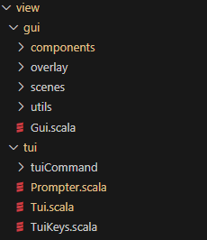
5. View
Two synchronized interfaces for flexible interaction:
GUI (ScalaFX) – Animated, interactive visual experience
TUI – Text-based, fast for debugging and logic testing
Both are observers that update automatically via event dispatching

Slide 11
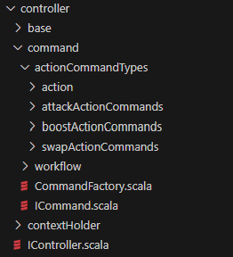
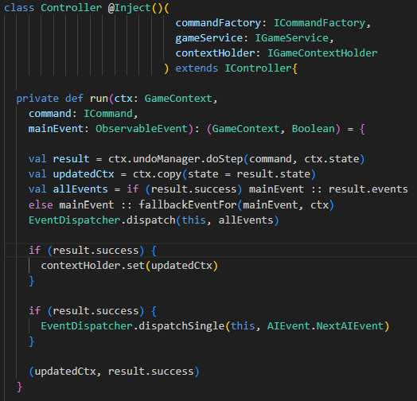
5. Controller
Translates user input into commands
Applies changes via an UndoManager
Updates a shared, immutable GameContext
Emits events to observers using a Mediator (EventDispatcher)

Slide 12
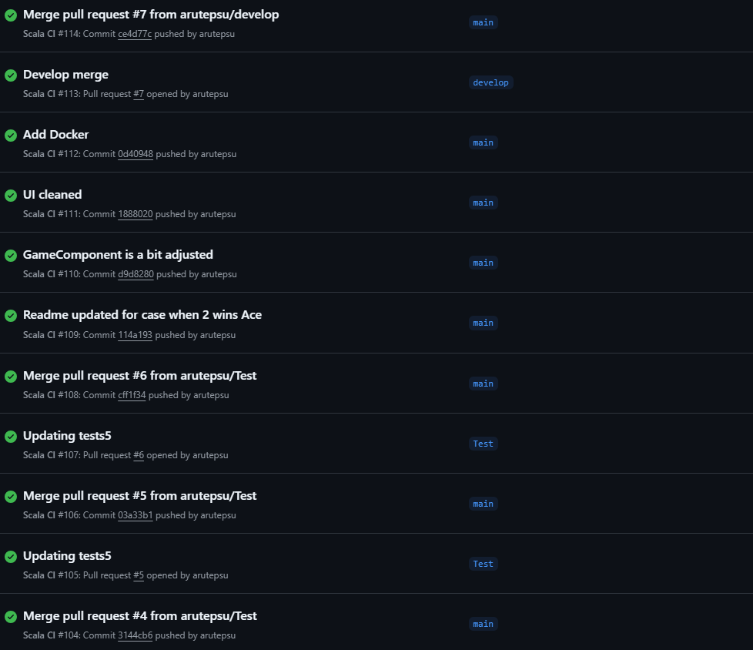
6. Continuous Deployment
Automates the process of building, testing, and releasing software
— so that every change can be deployed safely and quickly:
Code pushed to GitHub triggers the CI/CD pipeline
Automated tests run to verify correctness
Build is deployed automatically if tests pass
Fast feedback and early bug detection

Slide 13
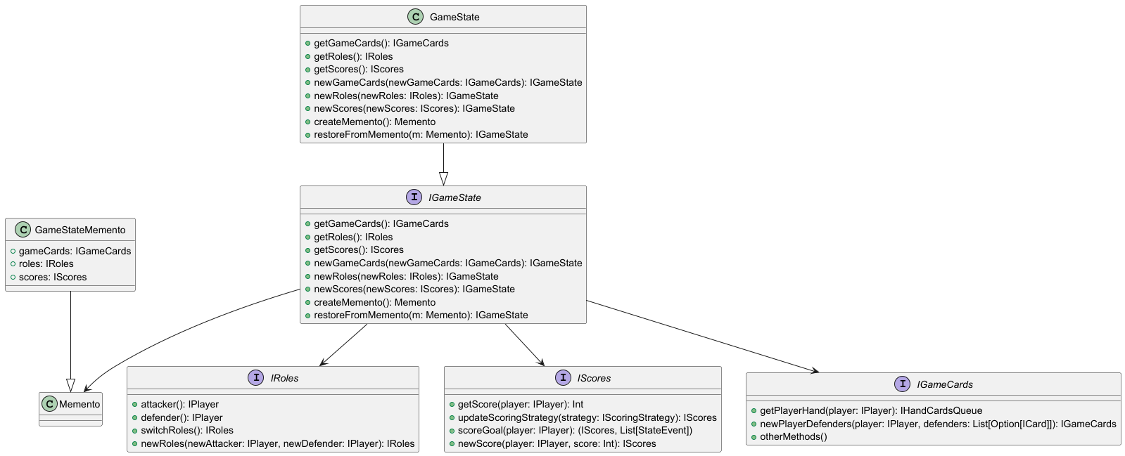
7. Design Patterns: Memento • Delegation • State
The GameState captures a full immutable game round:
player roles
Scores
card distributions
Every change (goal scored, role switched) creates a new GameState.
This ensures functional purity, enables undo/redo (Memento), and delegates logic to components like Roles and Scores.

Slide 14
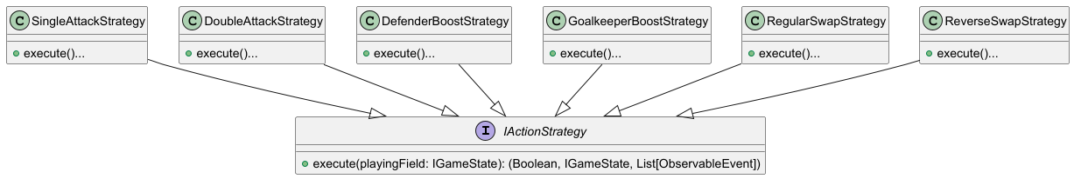
7. Design Patterns: Strategy
In-game actions like attacks, boosts, and swaps follow customizable rules — all unified under a shared interface: IActionStrategy.
Each behavior (like SingleAttackStrategy, DefenderBoostStrategy…) is a concrete implementation, encapsulating its logic.

Slide 15
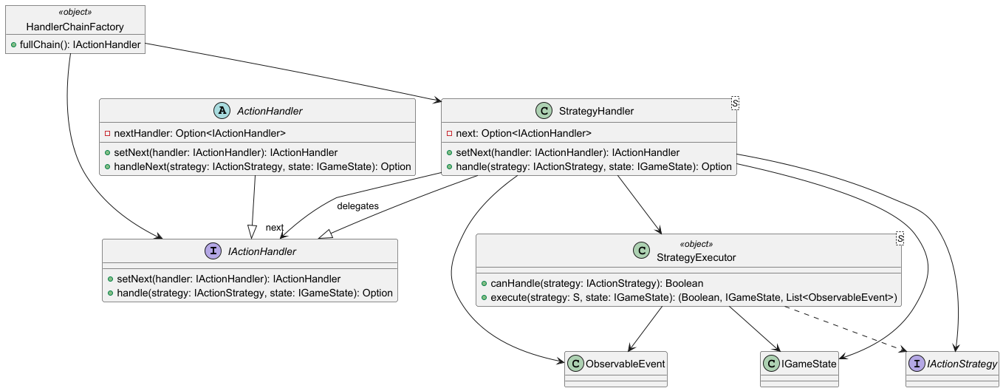
7. Design Patterns: Chain of Responsibility
How it works
Player triggers an IActionStrategy
The first StrategyHandler checks if its StrategyExecutor can handle it
If not, it calls handleNext(...) and delegates to the next handler
When a match is found, the handler executes the strategy and returns the updated game state + events
In-game actions like attacks, boosts, and swaps are processed through a chain of handlers — avoiding complex if-else logic.

Slide 16
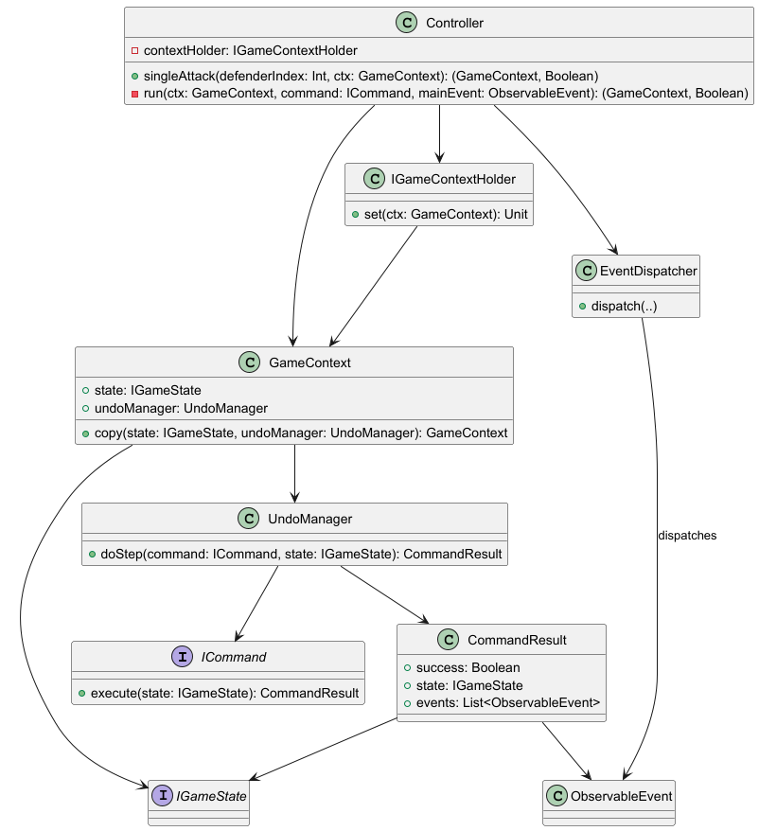
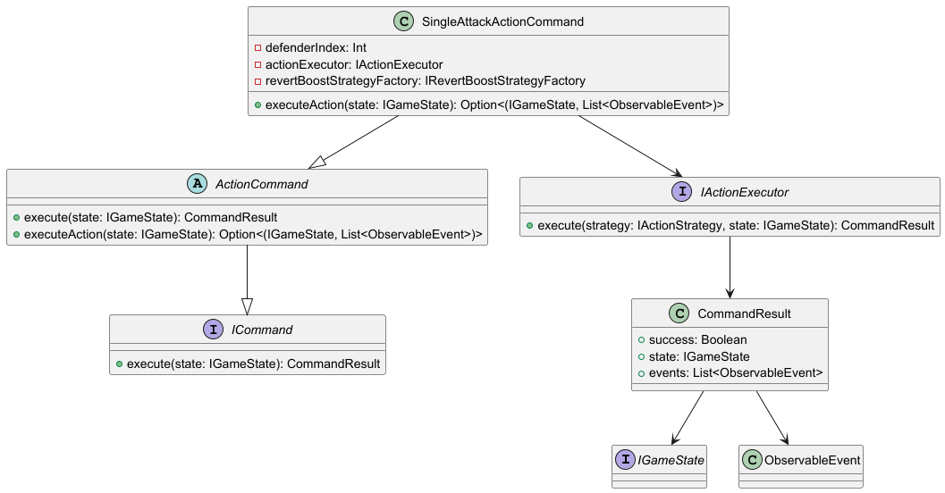
7. Design Patterns: Command, Mediator, Observer, Undo
The Controller coordinates execution, undo handling, and event dispatching using multiple patterns:
Command – encapsulates each game action as a reusable command
Mediator – EventDispatcher decouples event flow
Observer – GUI and TUI observe updates and react
Undo – UndoManager enables safe, reversible state changes

Slide 17
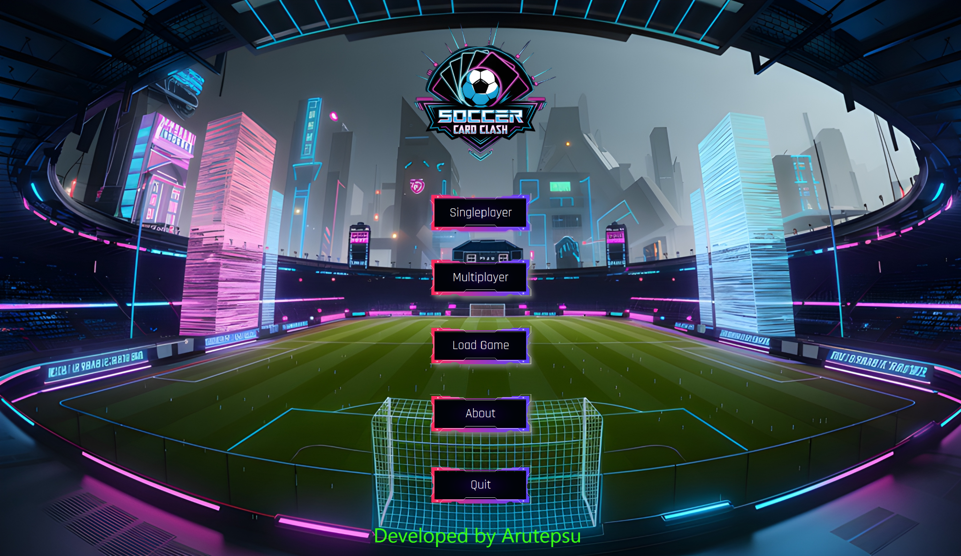
8. GUI

Slide 18
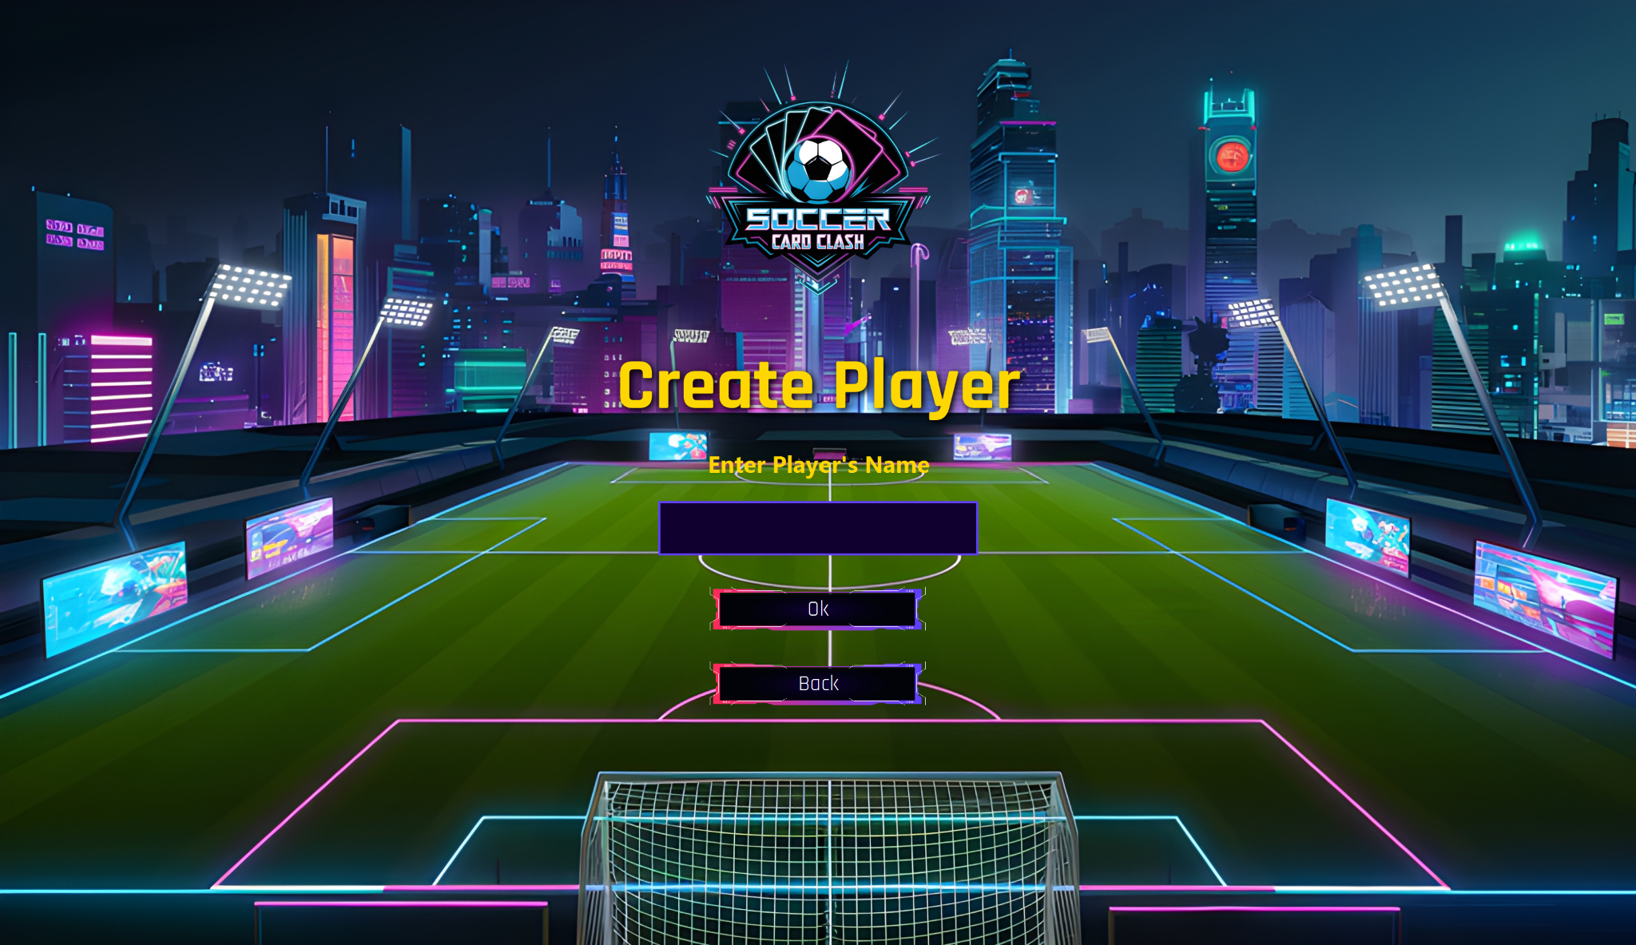
8. GUI

Slide 19
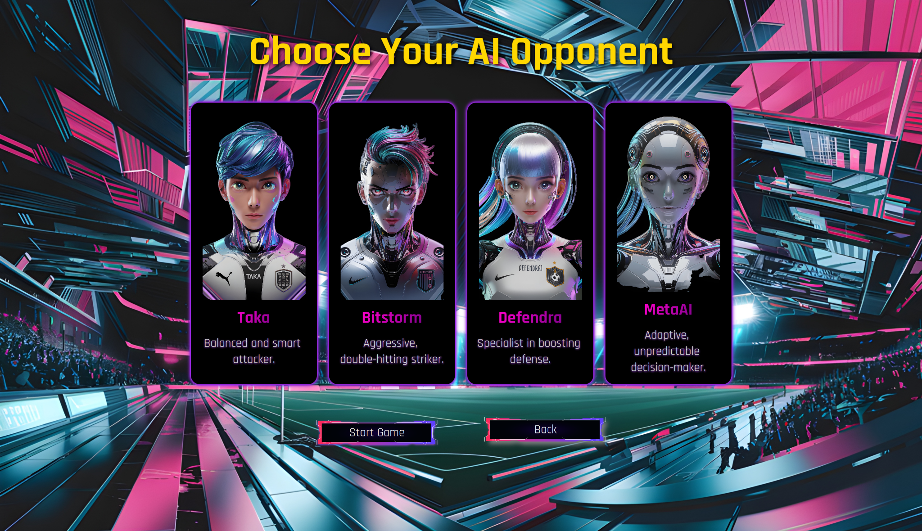
8. GUI

Slide 20
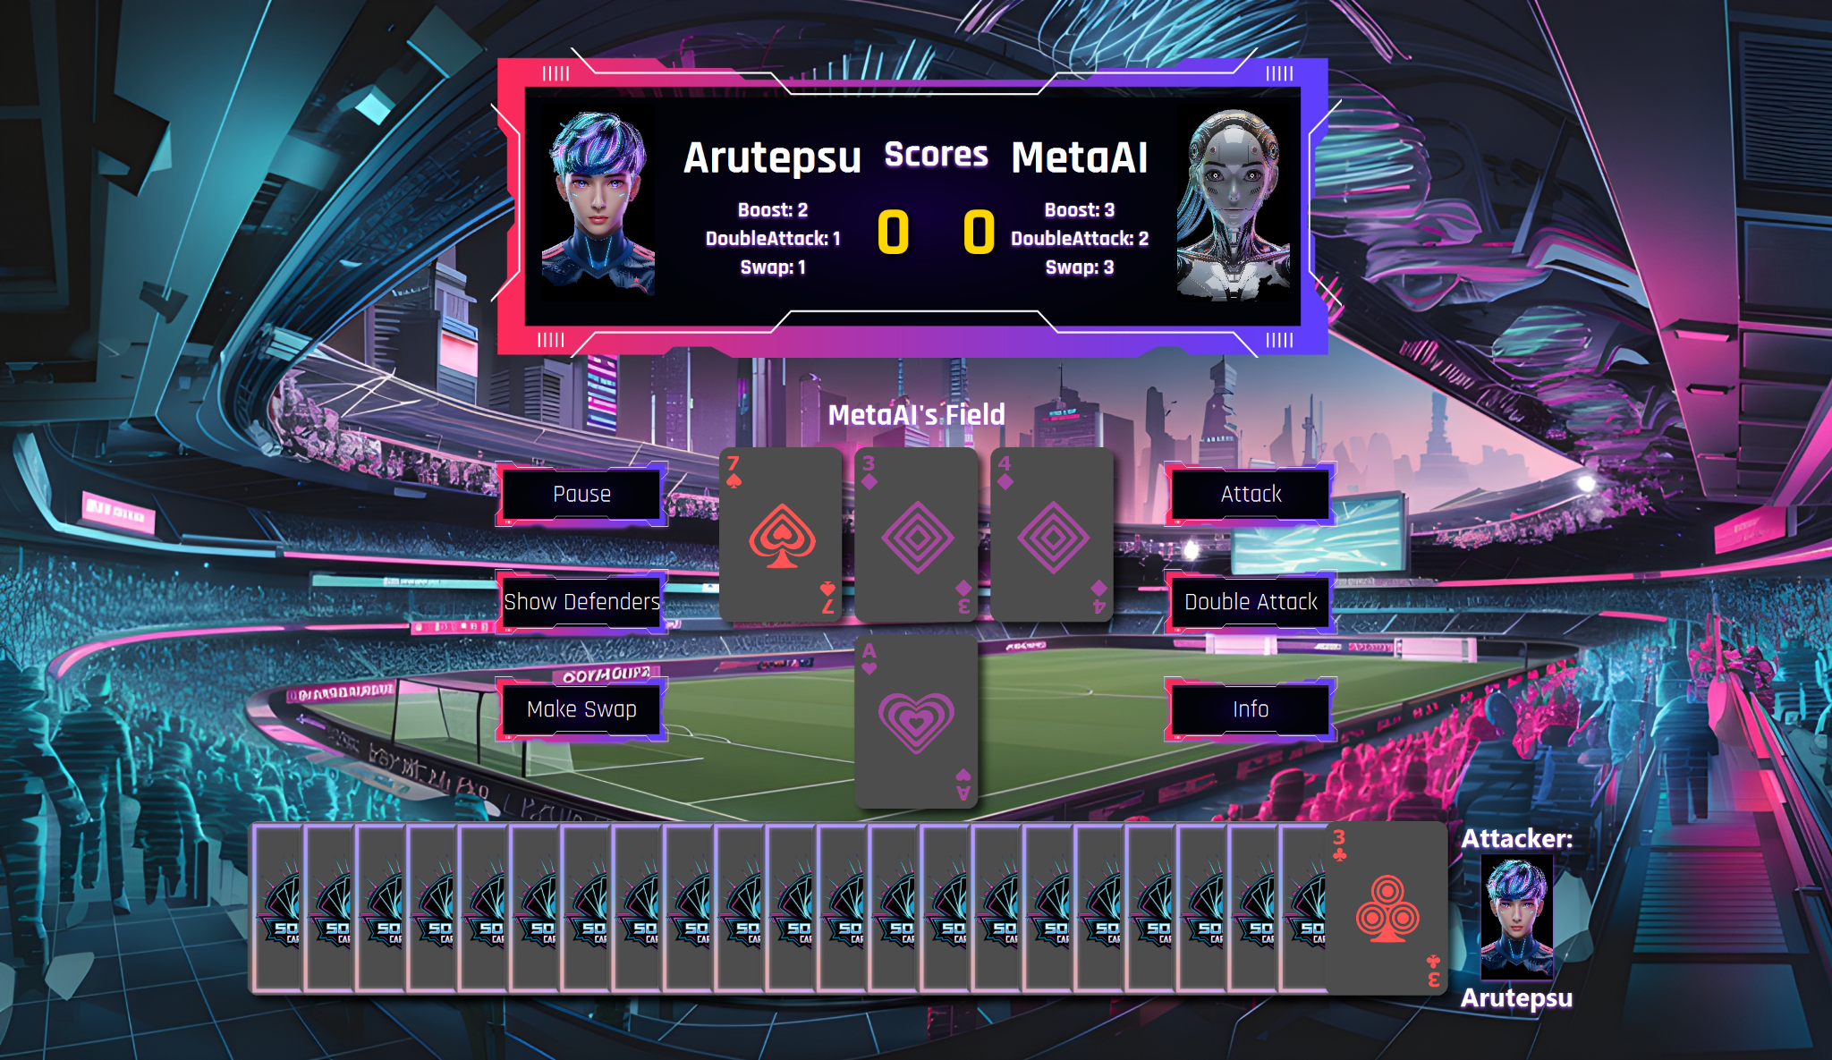
8. GUI

Slide 21
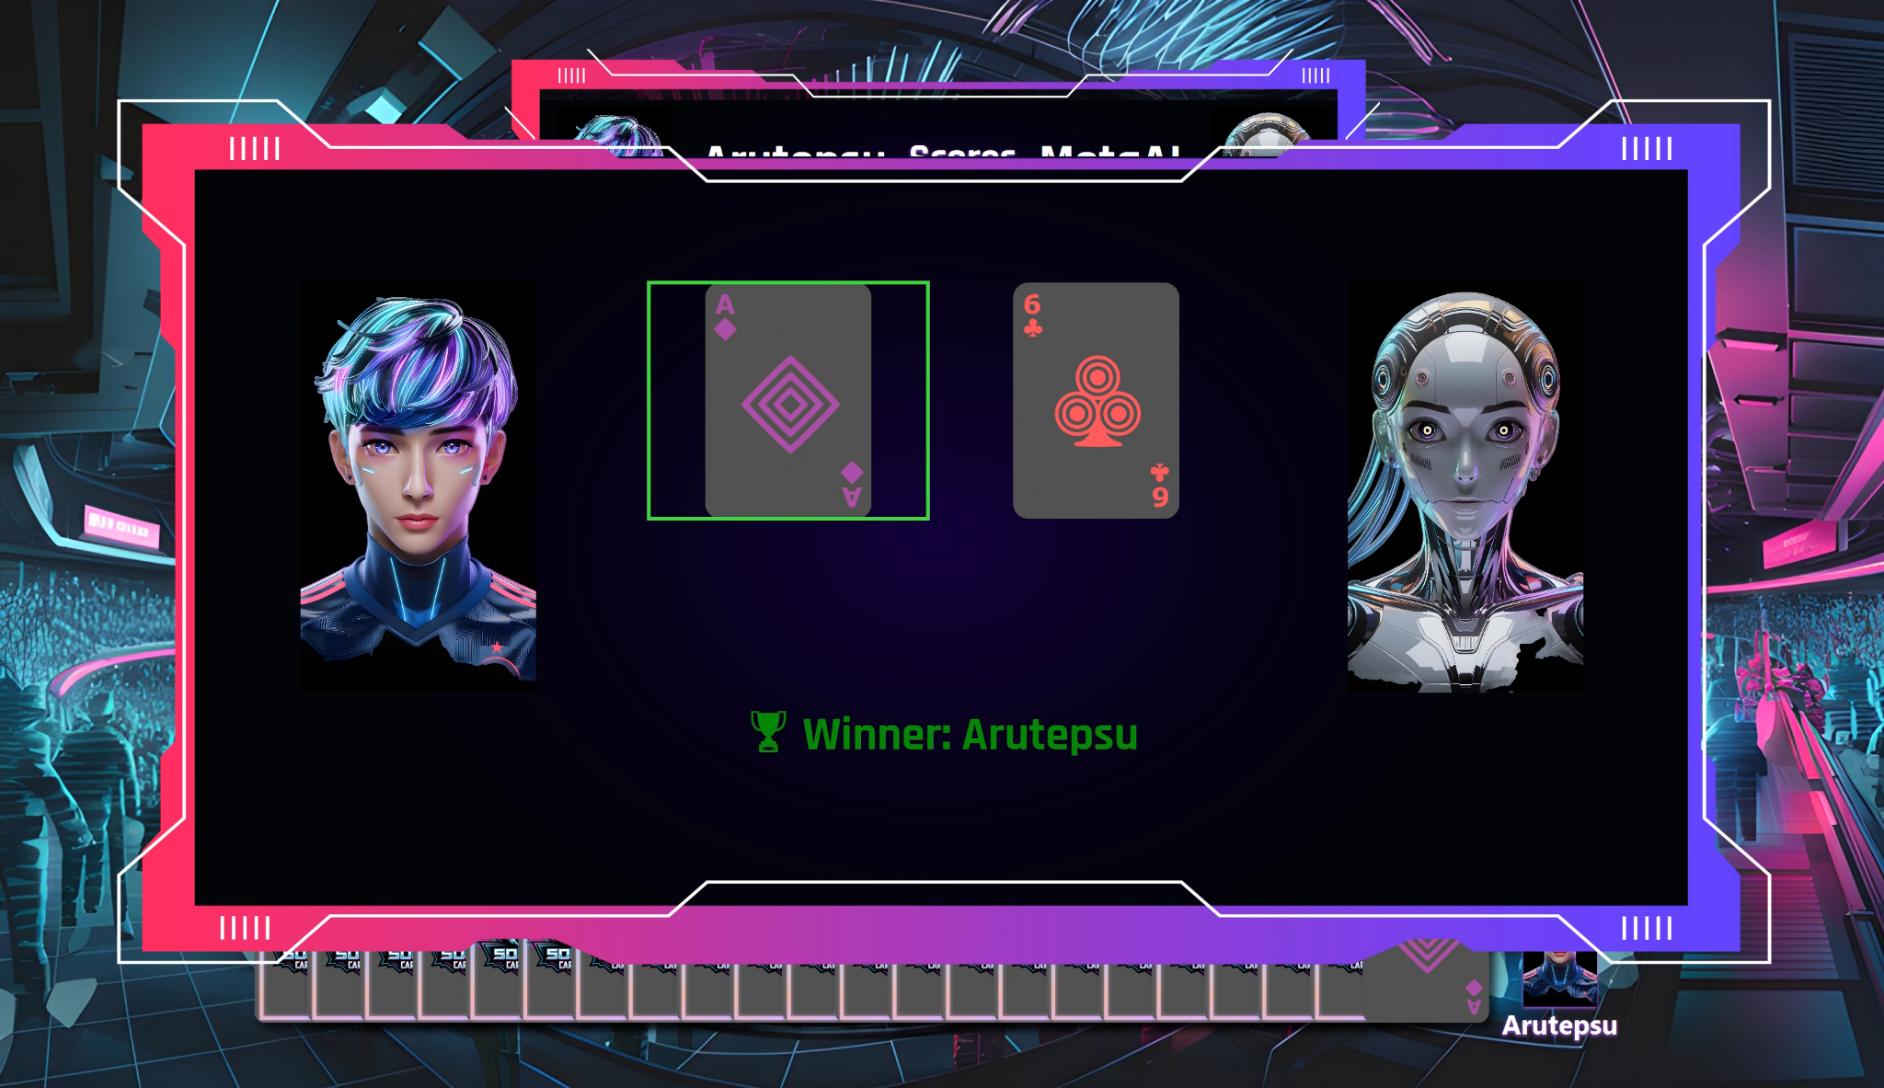
8. GUI

Slide 22
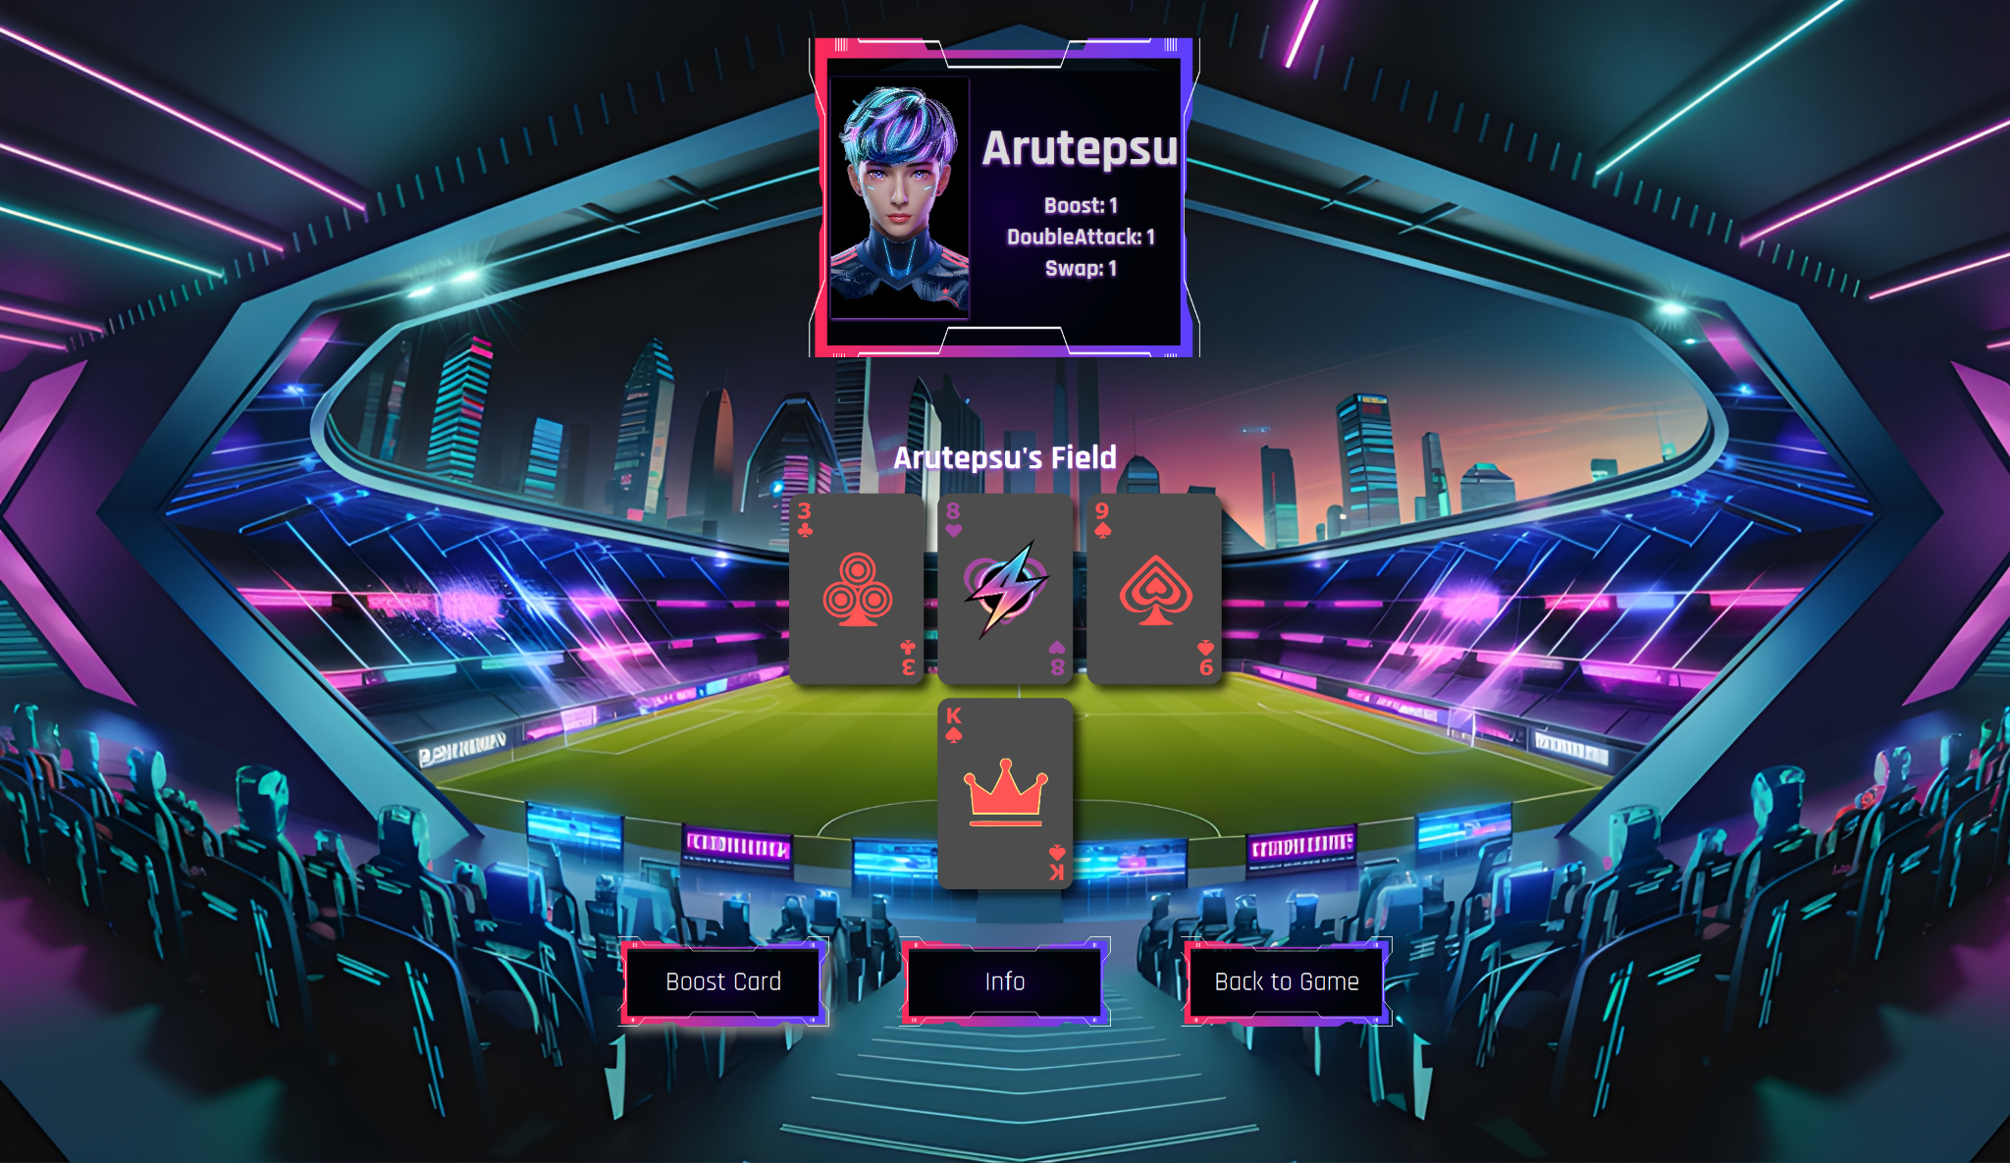
8. GUI

Slide 23
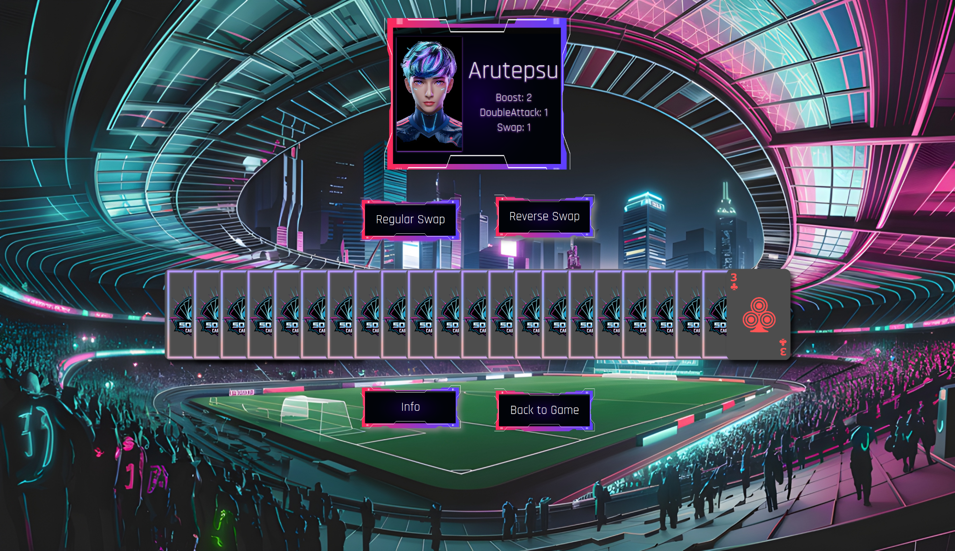
8. GUI

Slide 24
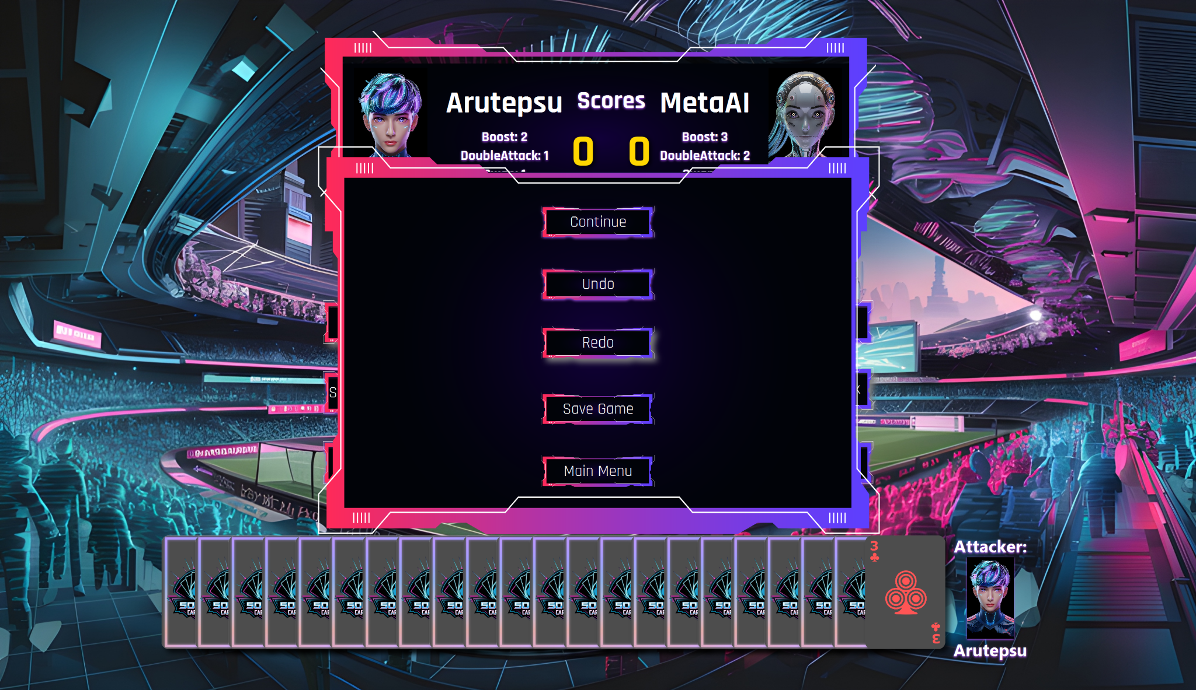
8. GUI

Slide 25
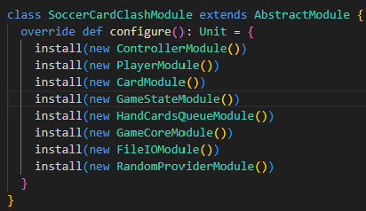
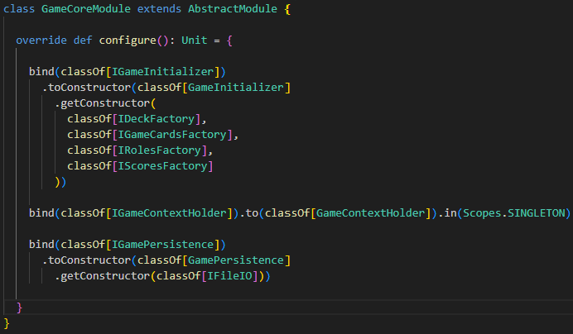
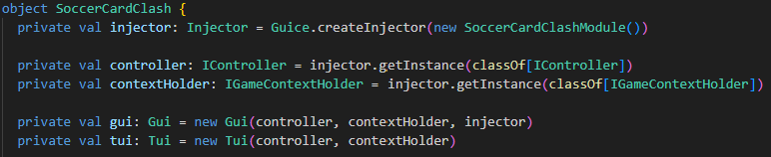
9. DI
The project uses Google Guice to handle dependency injection — enabling modular design, testability, and clean wiring of components.

Slide 26
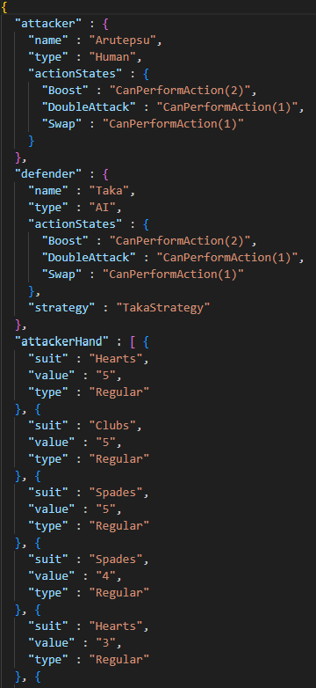
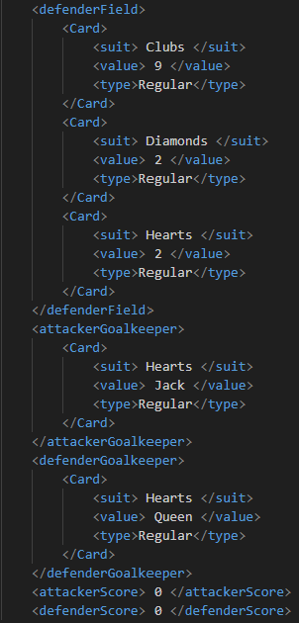
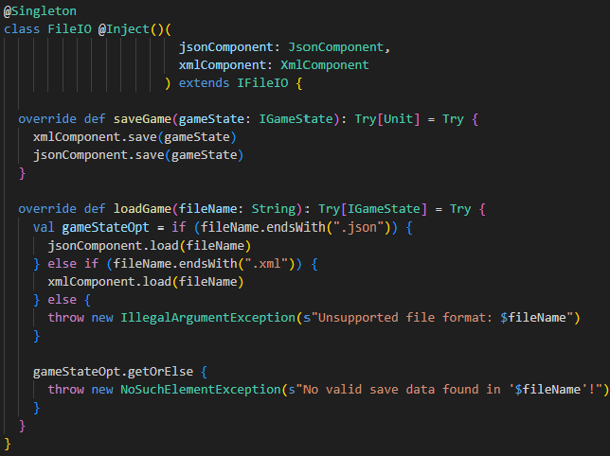
10. File IO
JSON
XML
The FileIO system allows the game to be persisted and restored via JSON or XML formats, supporting flexibility and long-term storage.

Slide 27
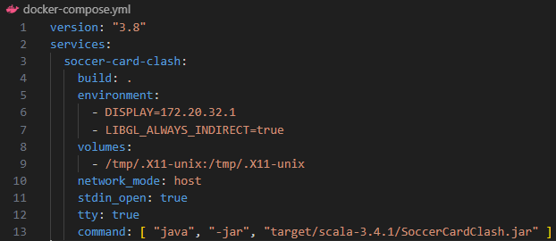
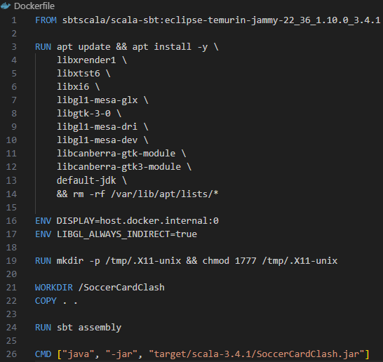
11. Docker🐳
Improves portability, scalability, and easy deployment across different systems.
How it works:
From Dockerfile to Container
Docker builds a Docker image from the Dockerfile
The image runs inside a container
The Scala app runs in an isolated and consistent environment
GUI via X11
The GUI display signal is forwarded via X server to the host
Allows ScalaFX GUI apps to run inside the container with native rendering
TUI Interaction
The container provides an interactive shell
Enables communication with the TUI directly from the terminal

Slide 28
Thanks!
Do you have any questions?
Artur Chonov, SE

